Slide 1

A facial recognition survey
Emanoel bruno and RoGénes reis

Slide 2

INtrodution
Face Detection: Look at the picture and find a face in it.
Data Gathering: Extract unique characteristics of Kirill’s face that it can use to differentiate him from another person, like eyes, mouth, nose, etc.
Data Comparison: Despite variations in light or expression, it will compare those unique features to all the features of all the people you know.
Face Recognition: It will determine “Hey, that’s my boy Kirill!”

Slide 3
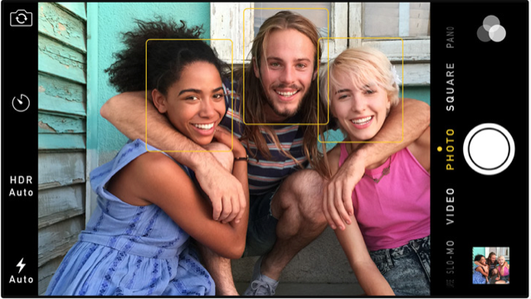
Face detection
Classifiers:
Haar Classifier
LBP Classifier
To use them you must import a file that contains the settings of the classifier

Slide 4



Haar Classifier
The Haar Classifier is a machine learning based approach
Created by Paul Viola and Michael Jones
Is trained from many many positive images (with faces) and negatives images (without faces).

Slide 5
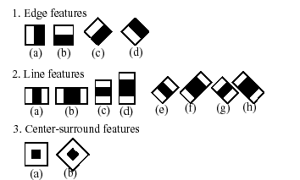
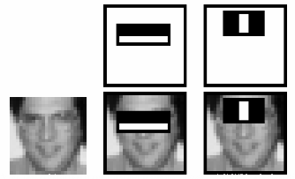
How it work?
Each window is placed on the picture to calculate a single feature.
The first one focuses on the property that the region of the eyes is often darker than the area of the nose and cheeks.
The second feature relies on the property that the eyes are darker than the bridge of the nose.

Slide 6
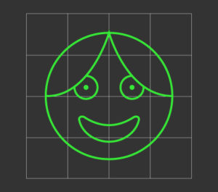
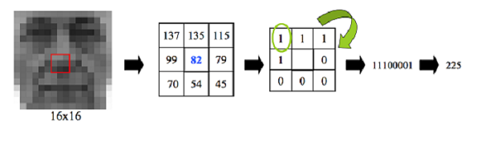
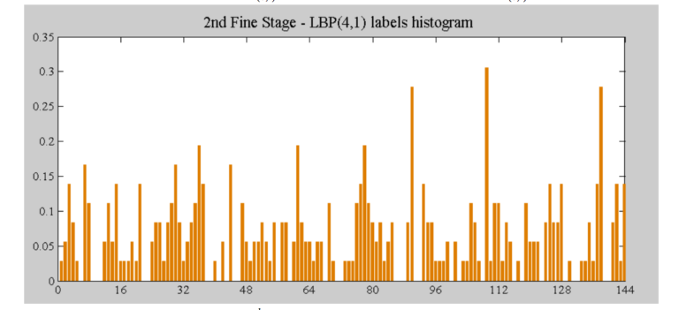
LBP Cascade Classifier
Local Bynary Patterns
LBP looks at 9 pixels (3×3 window)
Compares the central pixel value with every neighbor's pixel value under the 3×3 window.

Slide 7
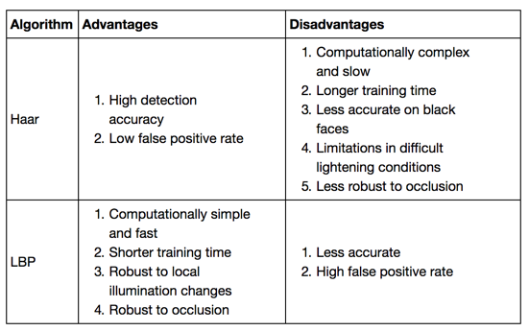
Haar vs LBP

Slide 8
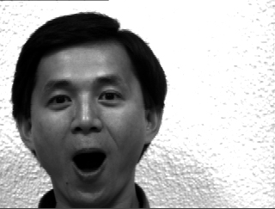
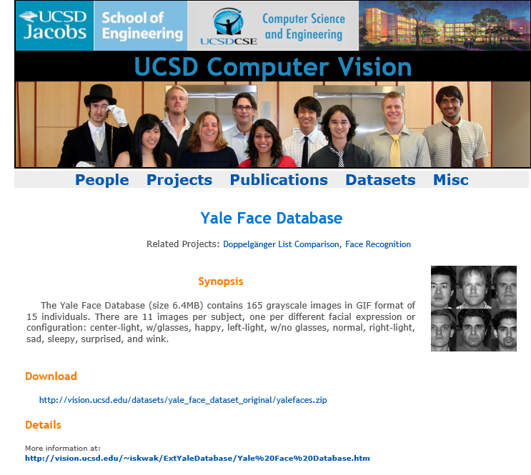
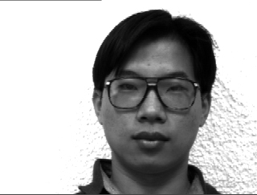
Yale Face Database

Slide 9
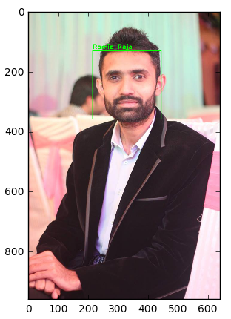

Face Recognition Algorithms
OpenCV
EigenFaces Face Recognizer
FisherFaces Face Recognizer
Local Binary Patterns Histograms (LBPH) Face Recognizer

Slide 10
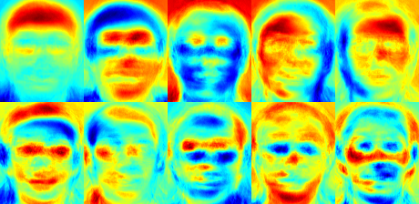
EigenFaces Face Recognizer
New image added:
Focus on look at areas with maximum variation
Extract the principal components from the new picture.
Compare those features with the list of elements stored during training.
Find the ones with the best match.
Return the ‘person’ label associated with that best match component.
EigenFaces Face Recognizer Principal Components.

Slide 11
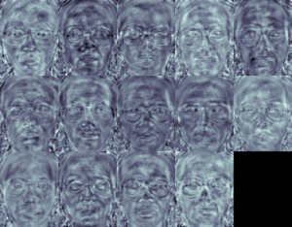
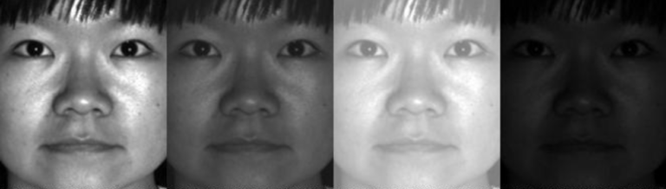
FisherFaces Face Recognizer
This algorithm is an improved version of the last one.
Since EigenFaces also finds illumination as a useful component, it will find this variation very relevant for face recognition and may discard the features of the other people's faces, considering them less useful.
FisherFaces face recognizer algorithm extracts principal components that differentiate one person from the others.
FisherFaces Face Recognizer Principal Components

Slide 12
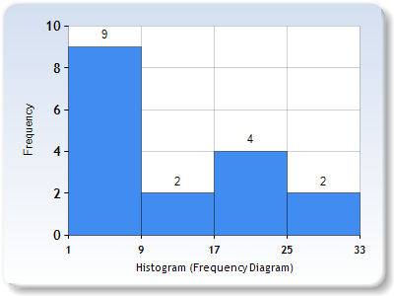
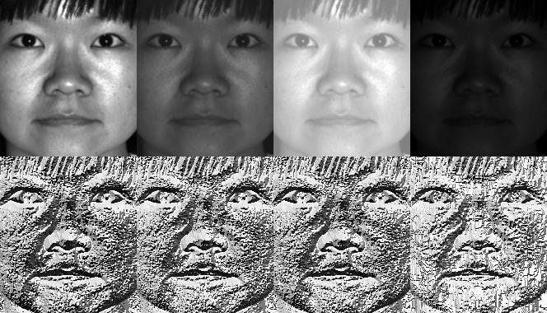
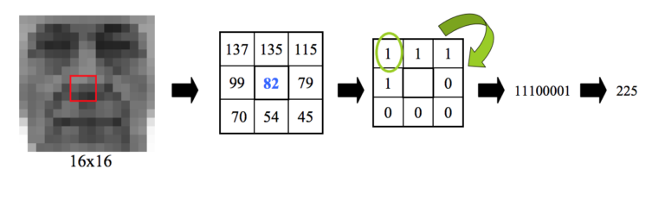
LBPH Face Recognizer
Feed a new image to the recognizer for face recognition.
The recognizer generates a histogram for that new picture.
It then compares that histogram with the histograms it already has.
Finally, it finds the best match and returns the person label associated with that best match.

Slide 13
RESULTS
Image x Identified person
Statistic data
 | Eigen | Fisher | LBPH | Expected outcome
1 | s1 | s1 | s1 | s1
2 | s5 | s2 | s2 | s2
3 | s3 | s3 | s3 | s3
4 | s1 | s3 | s4 | s4
5 | s1 | s6 | s2 | s5
6 | s6 | s6 | s6 | s6
7 | s6 | s7 | s7 | s7
8 | s2 | s5 | s8 | s8
9 | s2 | s2 | s9 | s9
10 | s6 | s5 | s10 | s10
11 | s11 | s11 | s11 | s11
12 | s1 | s3 | s5 | s12
13 | s6 | s7 | s13 | s13
14 | s6 | s14 | s14 | s14
15 | s3 | s3 | s15 | s15
 | Hit Rate | Error | False Positive | Hits
Eigen | 0,27 | 0,73 | 11 | 4
Fisher | 0,47 | 0,53 | 8 | 7
LBPH | 0,87 | 0,13 | 2 | 13

Slide 14
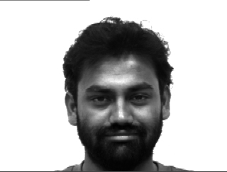
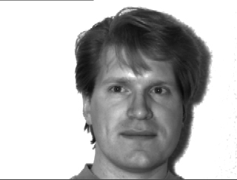
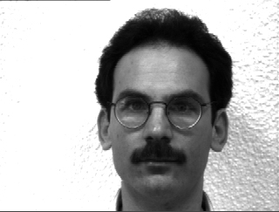
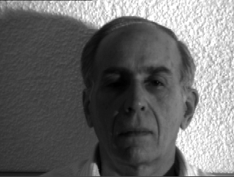
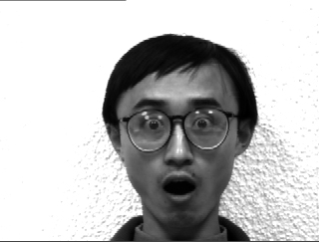
Comparations
s7
s1
LBPH
&
FISHER
All
s5
s8
s2
LBPH
&
FISHER
LBPH
LBPH

Slide 15
References
https://docs.opencv.org/2.4/modules/contrib/doc/facerec/facerec_tutorial.html
https://www.superdatascience.com/opencv-face-detection/
https://www.superdatascience.com/opencv-face-recognition/
http://fideloper.com/facial-detection

